Slide 1

LECTURE 15 – DIGITAL ELECTRONICS
Dr Richard Reilly
Dept. of Electronic & Electrical Engineering
Room 153,
Engineering Building

Slide 2
Memory Units: Flip-Flops
Four basic flip-flops:
  RS
  T
  D, and
  JK
  FF are usually used to build registers and counters

Slide 3
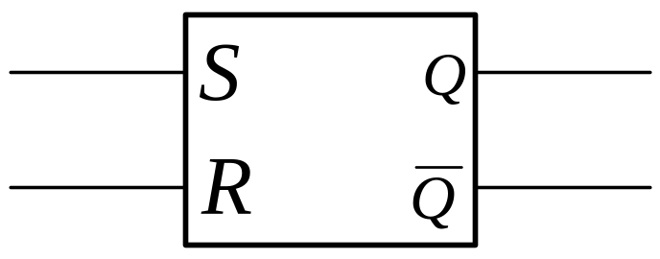
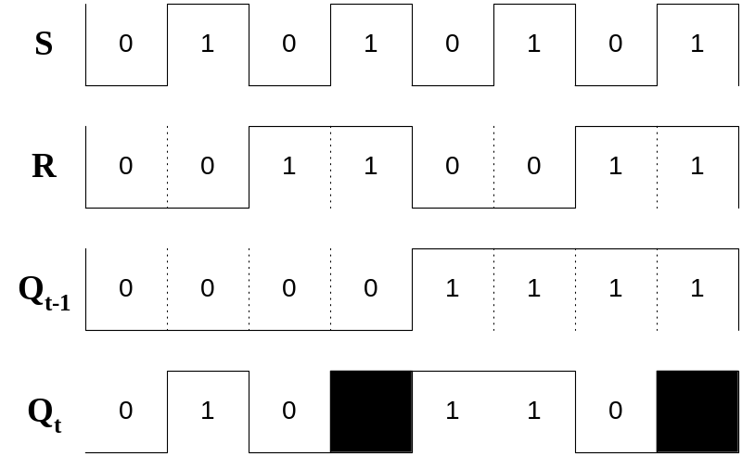


RS flip-flop
Simplest binary storage device.
NOTE : and are complements of each other.
Device is said to be
SET when Q output = 1
and
RESET when Q output = 0
Pulse widths are of arbitrary length

Slide 4
Excitation Table for RS flip-flop
Truth tables for flip-flops are called excitation tables.
Q_{t-1}
S
R
Q_{t}
0
0
0
0
0
0
1
0
0
1
0
1
0
1
1
indeterminate
⇒ depends on which input goes to 1 first
1
0
0
1
1
0
1
0
1
1
0
1
1
1
1
indeterminate
⇒ depends on which input goes to 1 first

Slide 5
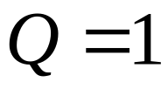
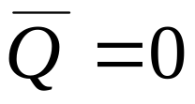
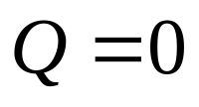
RS flip-flop
S and R are active high ⇒ action occurs a logical 1.
The memory capability :
  The S inputs sets the flip-flop and
  outputs remain in that condition after the excitation inputs go inactive
⇒ flip-flops store the active set input by causing
and flip-flop stores the active reset input by causing
As no synchronising clock is present ⇒ the flip-flop is said to be asynchronous.
  Asynchronous flip-flops are often named LATCHes.

Slide 6
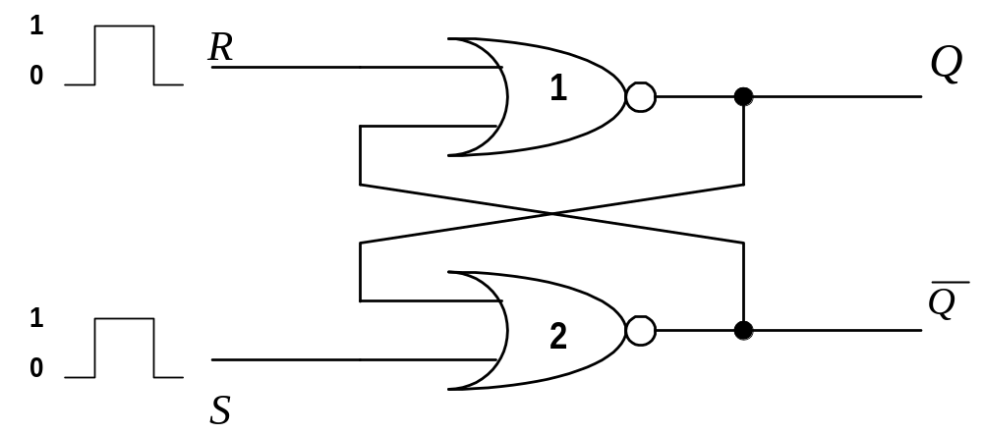
Implementation of RS-Flip-Flop
RS-flip-flops can be formed from 2 NAND gates and 2 NOR gates.
The cross-coupling from the output of one gate to the input of the other gate constitutes a feedback path.
Both inputs remain at 0 normally until state of flip-flop has to be changed

Slide 7

Implementation of RS-Flip-Flop
To analyse operation of NOR implementation
  output of a NOR = 0 if any input = 1
  output of a NOR = 1 if both/all inputs = 0
1. As a starting point assume that S = 1 and R = 0.
  ⇒ since Gate 2 has an input = 1 ⇒
  ⇒ both inputs to Gate 1 = 0 ⇒
2. when S = 0 ⇒ outputs remain the same as Q =1
  ⇒ leaves one input to Gate 2 = 1 ⇒ remains = 0
  ⇒ both inputs to Gate 1 remain = 0 ⇒

Slide 8
Implementation of RS-Flip-Flop
3. Can show that a 1 at the Reset input
  ⇒ changes Q to a 0
4. when Reset input returns to 0
  ⇒ the outputs do not change

Slide 9
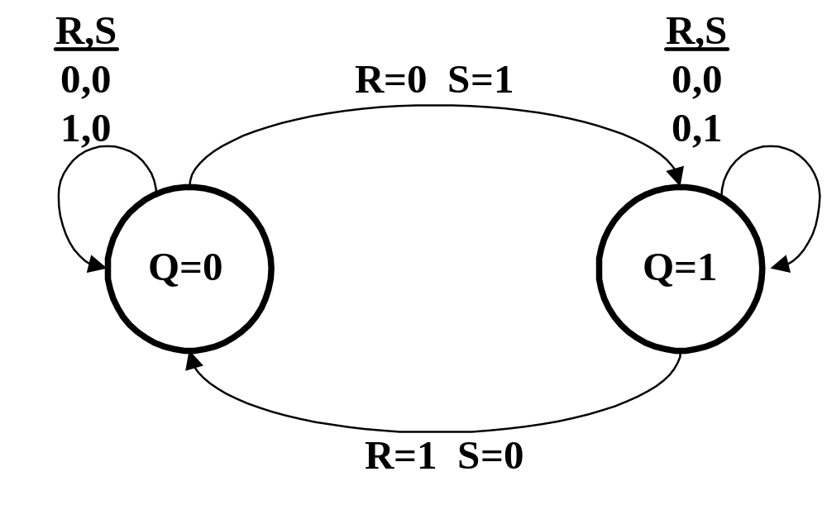
State Flow Diagram of RS-Flip-Flop
State flow diagram illustrates
  The two stable states of the RS-flip-flop
  All stable and unstable transitions to the Q=1 state
  Similarly starting at the Q=1 state, an R=1 input will produce a transition to the Q=0 state.

Slide 10
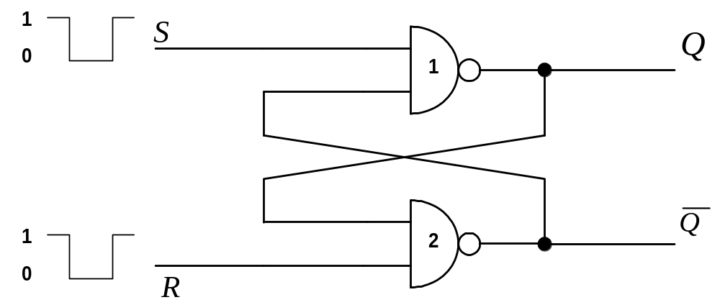
NAND Implementation of RS-Flip-Flop
Another Implementation can be with NAND gates
Both inputs remain at 1 normally until state of flip-flop has to be changed
NOTE : position of S and R

Slide 11
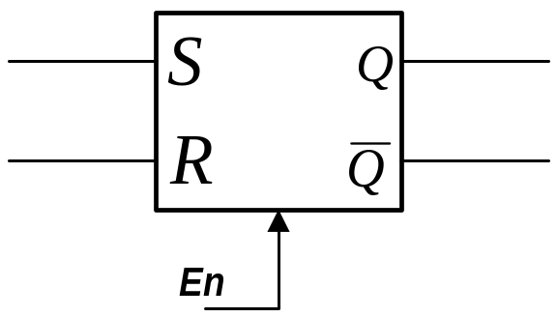
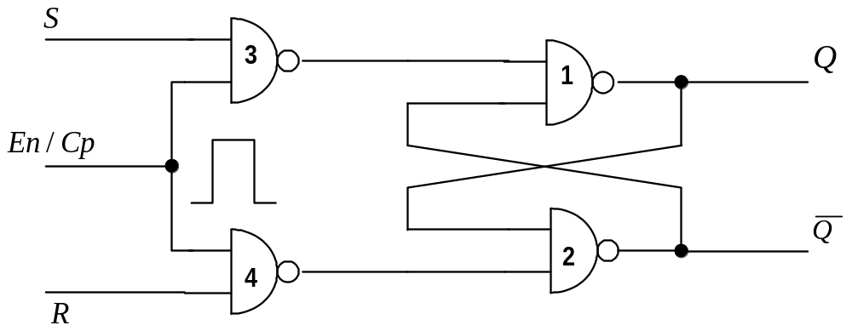
RS-Flip-Flop with Enable/Clock input
Can have implementation with an enable/clock

Slide 12

Indeterminate State
The indeterminate state makes the RS flip-flop difficult to manage and it is seldom used in practice
Nevertheless,
  an important circuit as all other flip-flops can be constructed from it.
To overcome the problem with the indeterminate state ensure inputs S and R are never at logic 1 at the same time.
  Done in the D-flip-flop

Slide 13
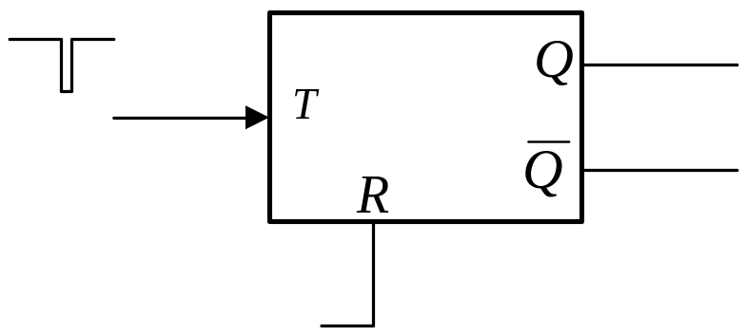
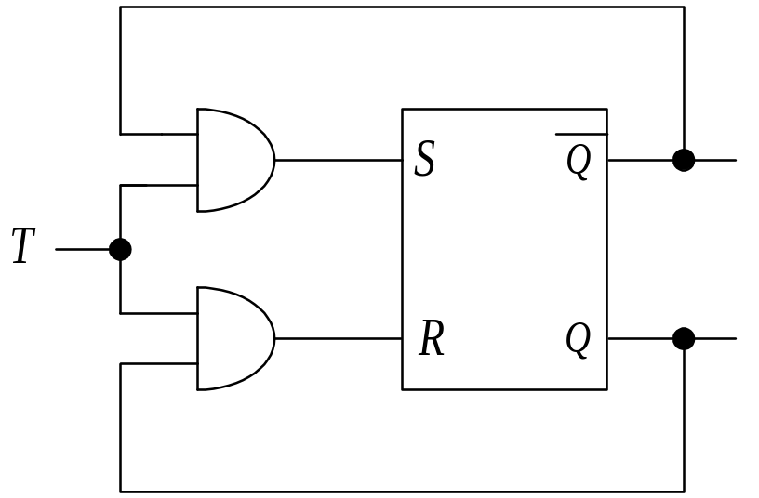
The T-flip-flop
Name “T” comes from the ability of the flip-flop to toggle or complement its state.
When pulse occurs while input T=1
⇒ flip-flop complements its output
When pulse occurs while input T=0
⇒ no change occurs
Q_{t-1}
T
Q_{t}
0
0
0
0
1
1
1
0
1
1
1
0

Slide 14
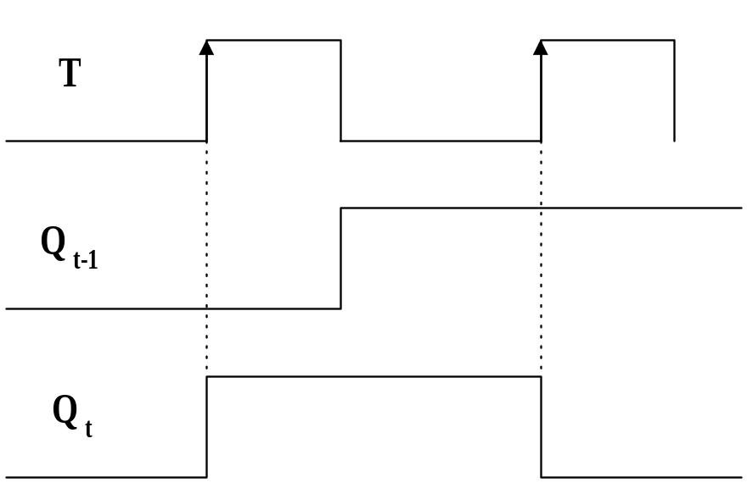
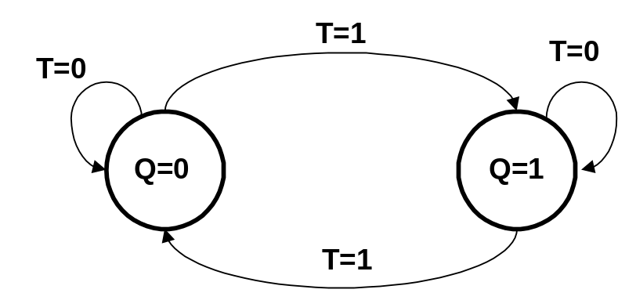
The T-flip-flop
Each time a pulse arrives the output changes state.
  in this case the negative edge triggers the flip-flop.
R is a reset input and will force Q to 0 irrespective of pulses

Slide 15
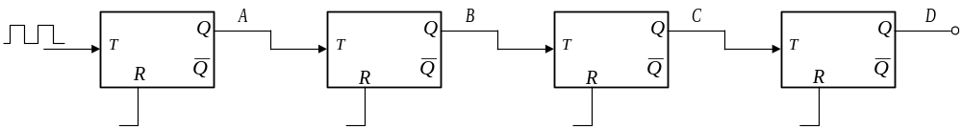
Example : Ripple Through Binary Counter
Operation
  At each negative edge of the input clock ⇒ flip-flop-A toggles, likewise at each negative edge of Q_A ⇒ flip-flop B toggles

Slide 16
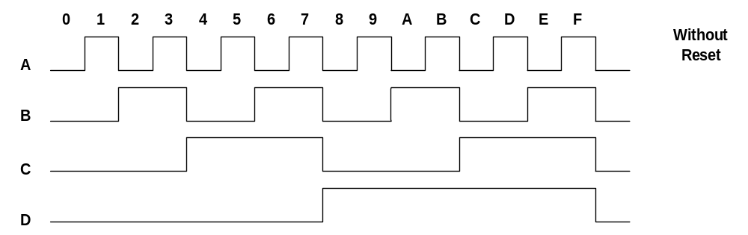
Example : Ripple Through Binary Counter
Outputs DCBA go through sequence and return to zero.

Slide 17
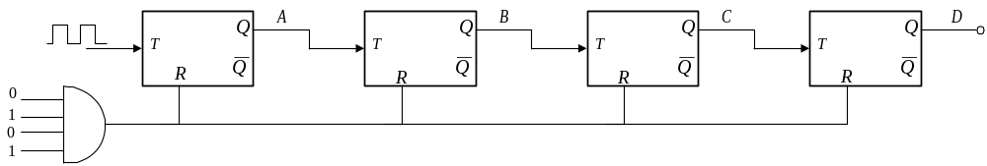
Example : Ripple Through Binary Counter Modulo-10
If we want a decade counter we can apply a reset when DCBA =1010 and force DCBA = 0000

Slide 18
The D-flip-flop
D flip-flop has 2 inputs, D and an Enable or Clock.
State of its Q output follows that of input at the time of the clock signal’s transition from low to high and is delayed by the device propagation time τ.
D type latch is a similar device
changes its output state when clock input is in high state
retains value when the clock input is in low state

Slide 19
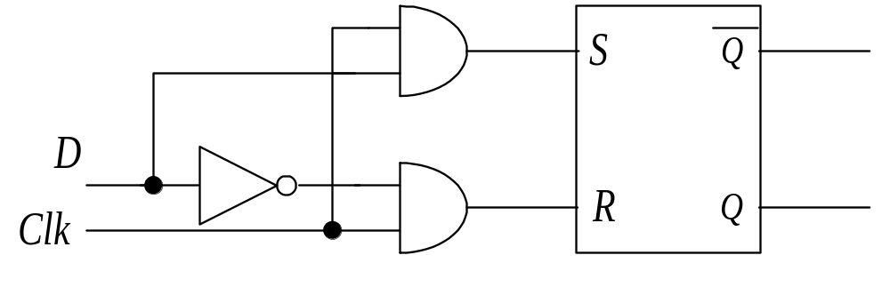
The D-flip-flop
As long as clock pulse is at 0
⇒ output of the AND gates are at logical level 0
and circuit cannot change regardless of the value of D
When clock pulse is at 1 ⇒ When D = 1 ⇒ Q = 1
When D = 0 ⇒ Q = 0

Slide 20
The D-flip-flop
The D-flip-flop is given its name because of its ability to hold data into its internal storage.
  sometimes called a gated D-latch.
From excitation table for D flip-flop, the next state of the flip-flop is independent of the present state since Q_{i-1} = D where Q = 0 or 1.
Q_{t-1}
D
Q_{t}
0
0
0
⇒ pulse at the enable pin will transfer value at input D to output independent of value of output before pulse was applied.
0
1
1
1
0
0
1
1
1

Slide 21
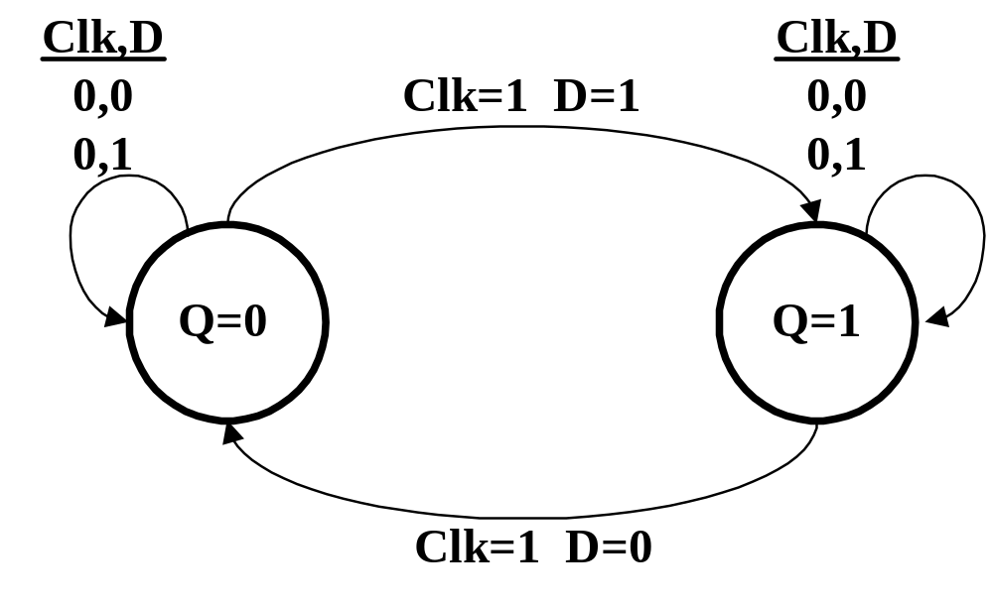
The D-flip-flop

Slide 22
JK-Flip-flop
This is a refinement of the R-S flip-flop in that the indeterminate state is defined in the J-K type.
  Input J behaves like input S
  input K behaves like input R
When both J and K are equal to 1 (the main problem with the RS-flip-flop)
⇒ the flip-flop switches to its complement state
if Q=1 ⇒ flip-flop switches to Q=0 .

Slide 23
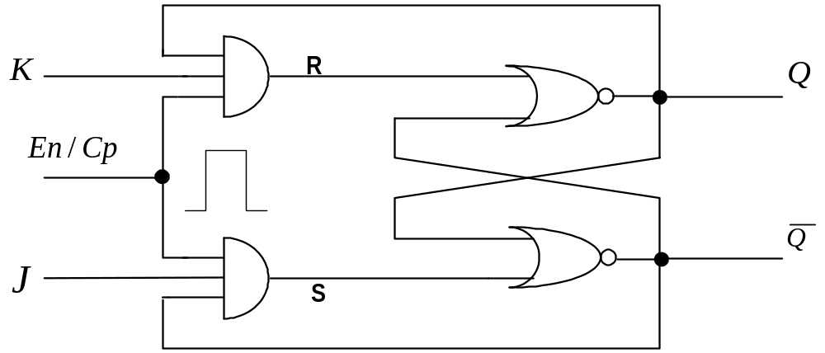

JK-Flip-flop
The output Q is AND’ed with inputs K and Enable.
⇒ Flip-flop cleared during a clock pulse only if Q was previously = 1.
Also output is AND’ed with inputs J and Enable.
⇒ Flip-flop set with a clock pulse only when was previously = 1.

Slide 24
JK-Flip-flop
When both J and Q are 1
⇒ input is transmitted through one AND gate only
Which one ? The one whose output is currently = 1
Q_{t-1}
J
K
Q_{t}
0
0
0
0
0
0
1
0
0
1
0
1
0
1
1
1
1
0
0
1
1
0
1
0
1
1
0
1
1
1
1
0

Slide 25
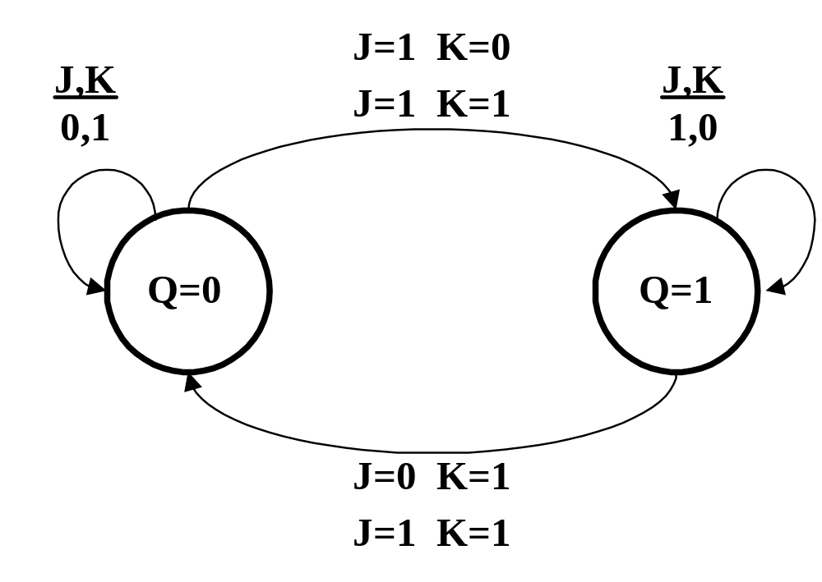
JK-Flip-flop

Slide 26
Triggering of Flip-flops
The state of a flip-flop is switched by a momentary change of the input signal.
  This momentary change is called a trigger and the transition is said to trigger the flip-flop.
Clocked flip-flops are triggered by pulses.
  Pulses start from an initial value of 0
  Go momentarily to 1
  And after a short time return to its initial 0 value

Slide 27
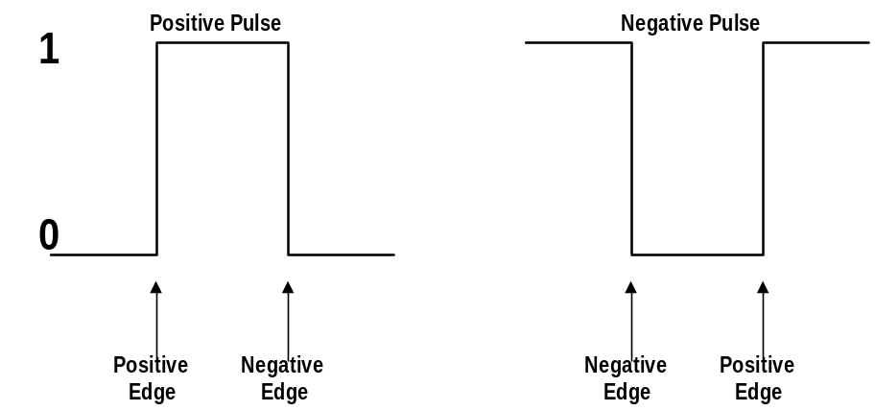
Triggering of Flip-flops
Feedback is the main problem with clocked flip-flops :
  feedback paths between combinational circuits and memory elements can cause instability.
    must make sure output of flip-flop do not start changing until pulse input has returned to 0.
better to make flip-flop sensitive to pulse transitions rather than pulse duration
Design the flip-flop to respond only to edge-transitions
⇒ eliminate the multiple transition problem.

Slide 28
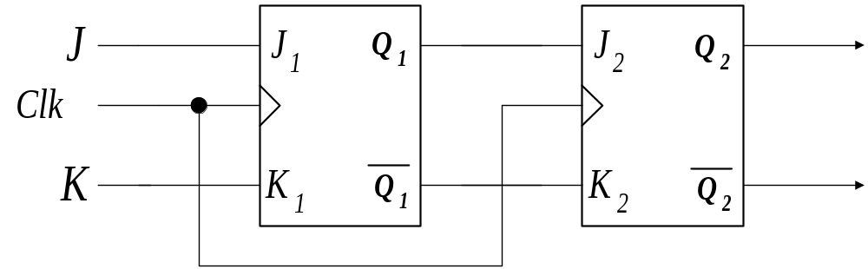
Master-Slave Flip-Flop Configuration
JK flip-flops are ideal for cascading to accomplish various sequential functions.
When two or more flip-flops are cascaded, both outputs of the first flip-flop are connected to the J and K inputs, respectively, of the second flip-flop.

Slide 29
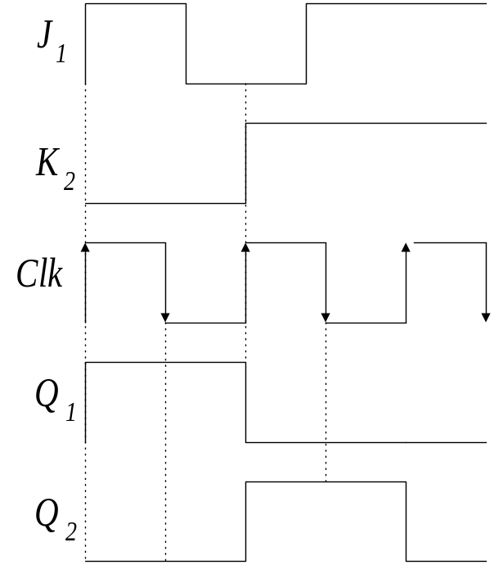
The Master-Slave Flip-Flop
The clock inputs to first flip-flop will cause a next state transition Q_{n+1} to occur on next clock input pulse.
Because of inherent path delays of first flip-flop outputs and clock signal, a race condition can occur, causing the second flip-flop to sense Q_{n+1} instead of Q_{n}

Slide 30
The Master-Slave Flip-Flop
A race condition occurs when two or more signal arrive at flip-flop’s inputs at different times, because of different path delays and cause the wrong output state to occur.
A race condition is avoided by using two flop-flops in cascade configured as a unit, one using the true clock and the other the complimented form.
  known as Master-Slave configuration

Slide 31
The Master-Slave Flip-Flop
or considering it another way….
It is important to realise that because of feedback connections in JK-flop-flop, an enable pulse that remains in logic 1 state while both J and K are equal to 1
  ⇒ will cause the output to complement again and repeat complementing until the enable pulse goes back to 0.
  ⇒ the enable pulse must be < the propagation delay time of the flip-flop.

Slide 32
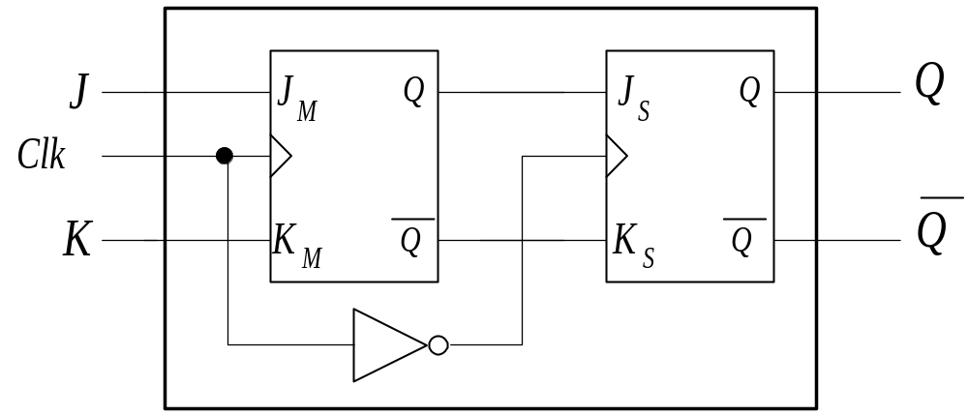
The Master-Slave Flip-Flop
This is a very restrictive requirement as operation of the circuit depends on the width of the pulse.
⇒ need to have a different design.
  The Master-Slave Construction

Slide 33
The Master-Slave Flip-Flop
Master is isolated from slave and input states are transferred to Master J and K inputs.
Inputs of Master flip-flop are inhibited and its output state is transferred to J and K inputs of slave flip-flop
Master-Slave configuration eliminates any race conditions.

Slide 34
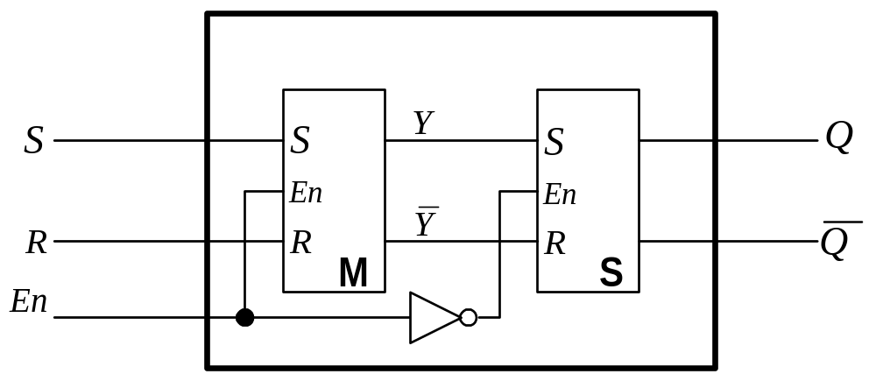

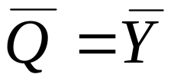
The Master-Slave Flip-Flop
An RS flip-flop implementation also exists
When Clock pulse, at the enable, = 0
  ⇒ Output of inverter = 1
  ⇒ Slave enabled (while master disabled)
  ⇒ and

Slide 35
The Master-Slave Flip-Flop
When Clock pulse, at the enable, = 1
  ⇒ information at R and S is transmitted to Master
  ⇒ Slave isolated as long as enable pulse = 1
When Clock pulse, at the enable, = 0
  ⇒ Master isolated
  ⇒ External inputs have no effect on Master
  ⇒ but Slave Flip-flop then goes to same state as Master flip-flop

Slide 36
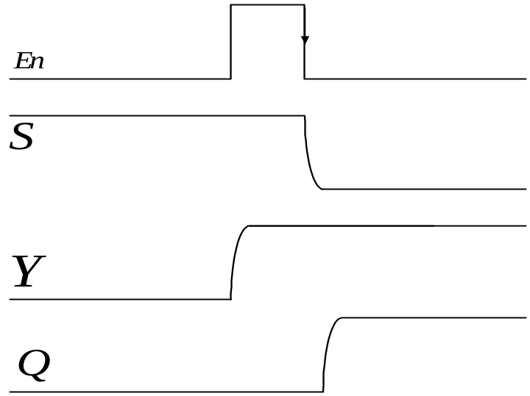
The Master-Slave Flip-Flop
Timing Diagram of Master-Slave flip-Flop
NOTE :
Master-Slave Flip-Flop allows switching of the outputs of flip-flop on negative edge transition of clock pulse.
  In this arrangement switches on the negative edge
  To switch on positive edge use another inverter between CP input and Master.

